Slide 1
FIT3077: HTML IS AN OOP LANGUAGE
CL MONDAY 6PM Team 37

Slide 2

Pygame
PyInstaller for packaging and distribution
Video games making library for Python
Handle graphics, sound, input, and network
Supports other libraries and tools
Free and open source

Slide 3
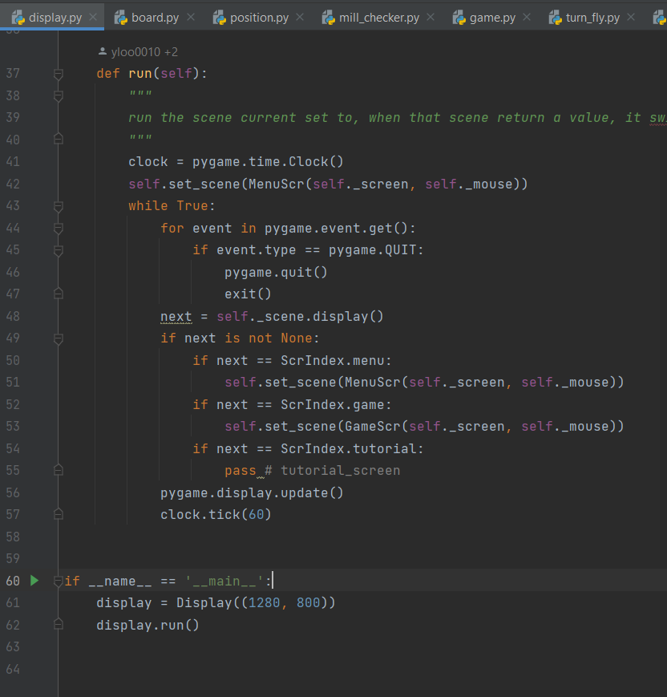
Pygame & Display
Notes:
Pygame handles the hard work of managing the display For stuff to display, scenes w/ subclasses for different scenes, loads and when interact that leads to another screen, display engine manage switch

Slide 4
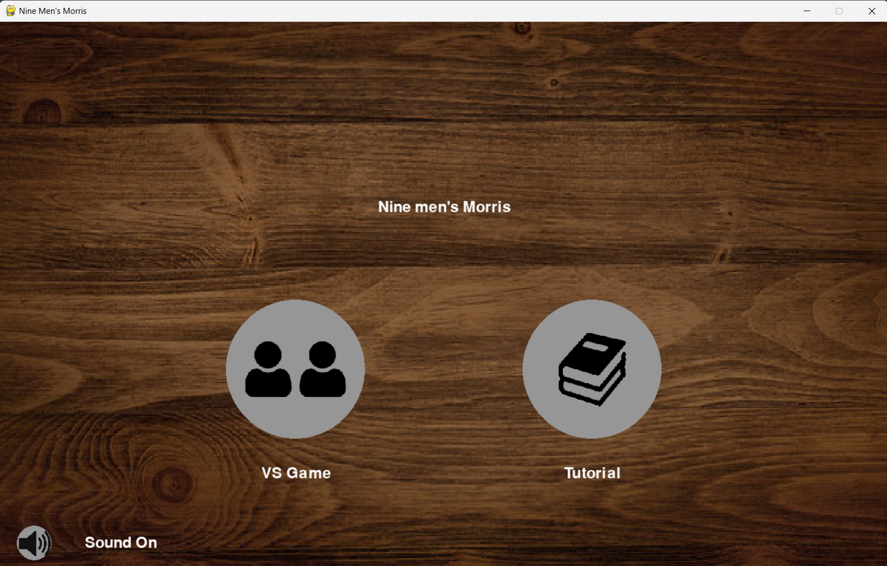
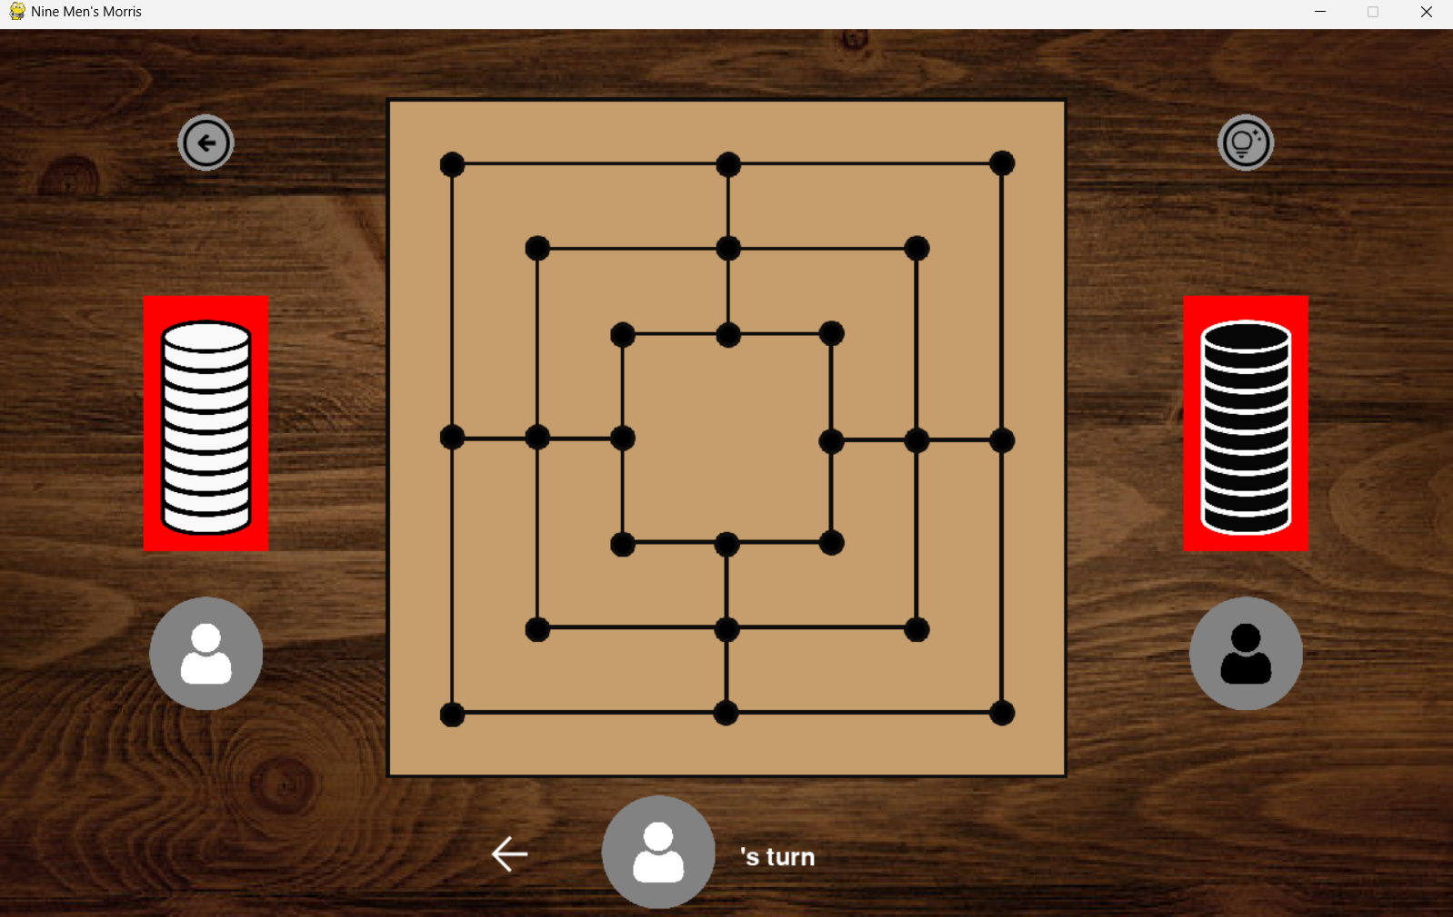
Scenes
in_rect(self, mouse_pos, xy, wh)
class SoundUtil
Notes:
Scene as parent class has common shared framework (buttons & sound management) button : (hover and change colour indicate, clicks with sounds) Click VS game -> gamemanager

Slide 5
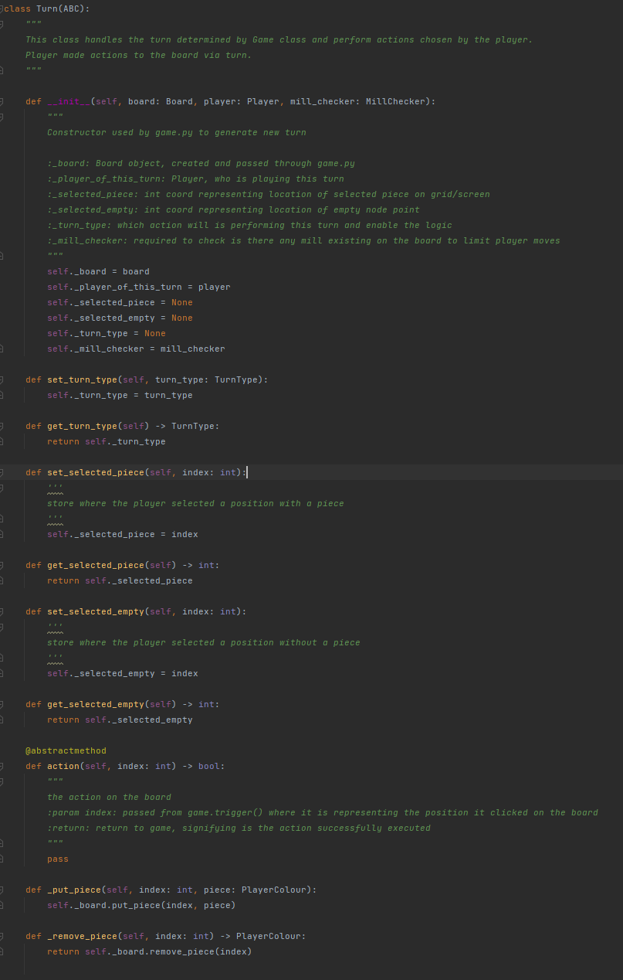
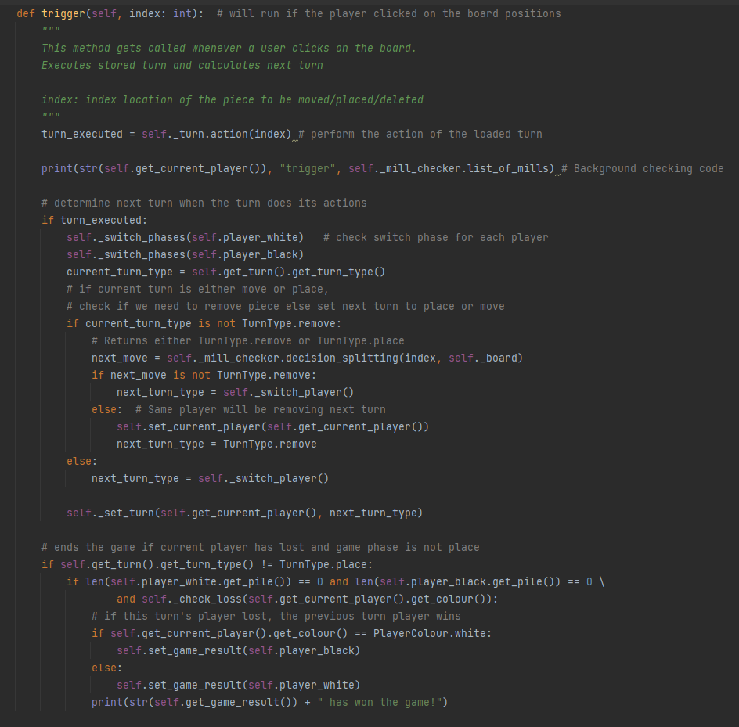
Onclick/Trigger + Turn Class

Slide 6
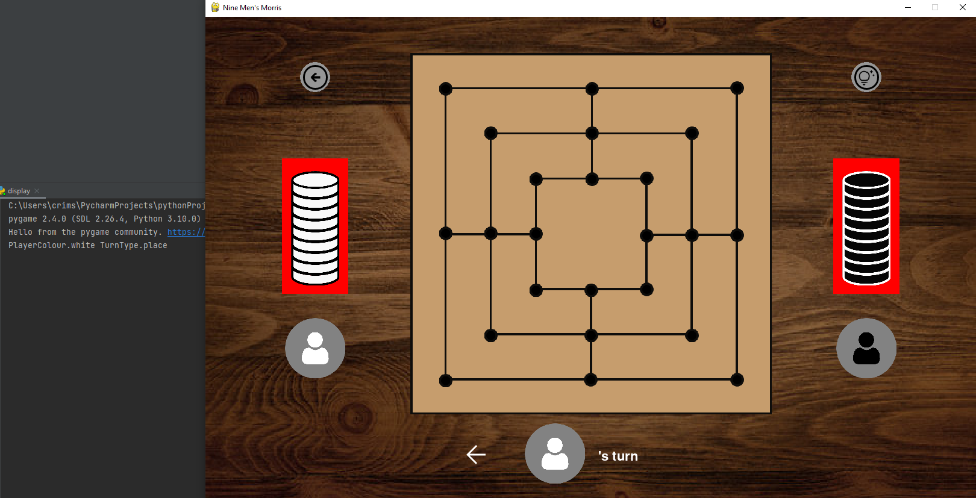
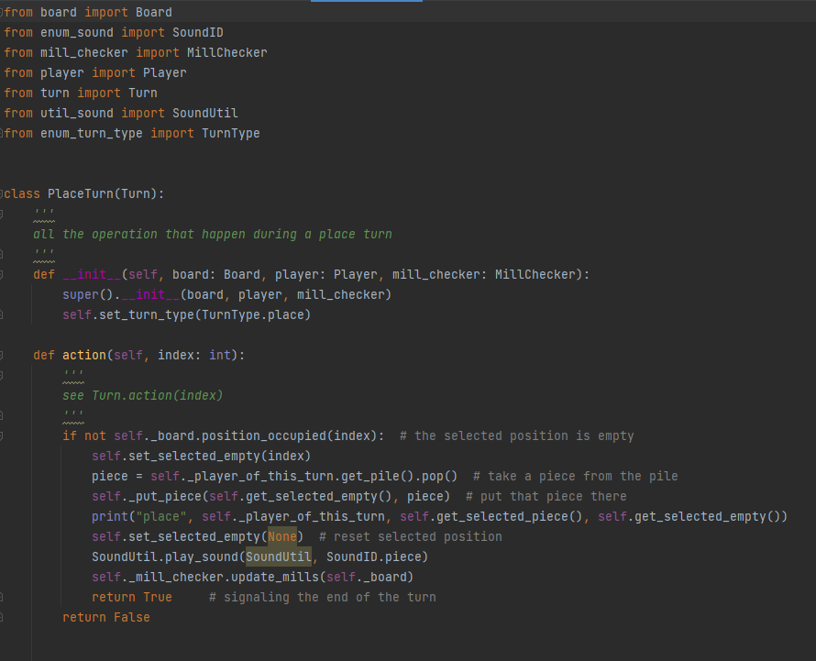
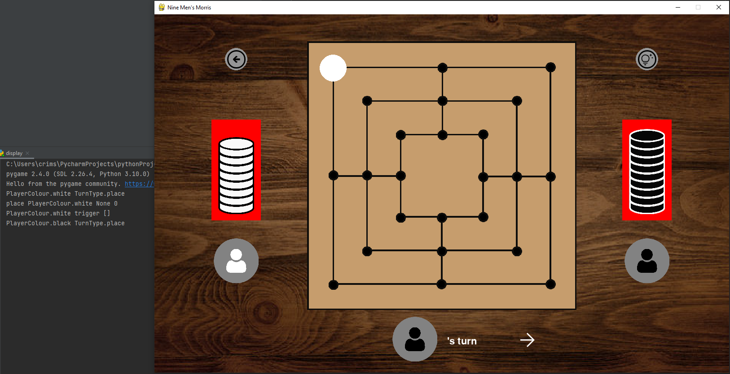
Place Turn

Slide 7
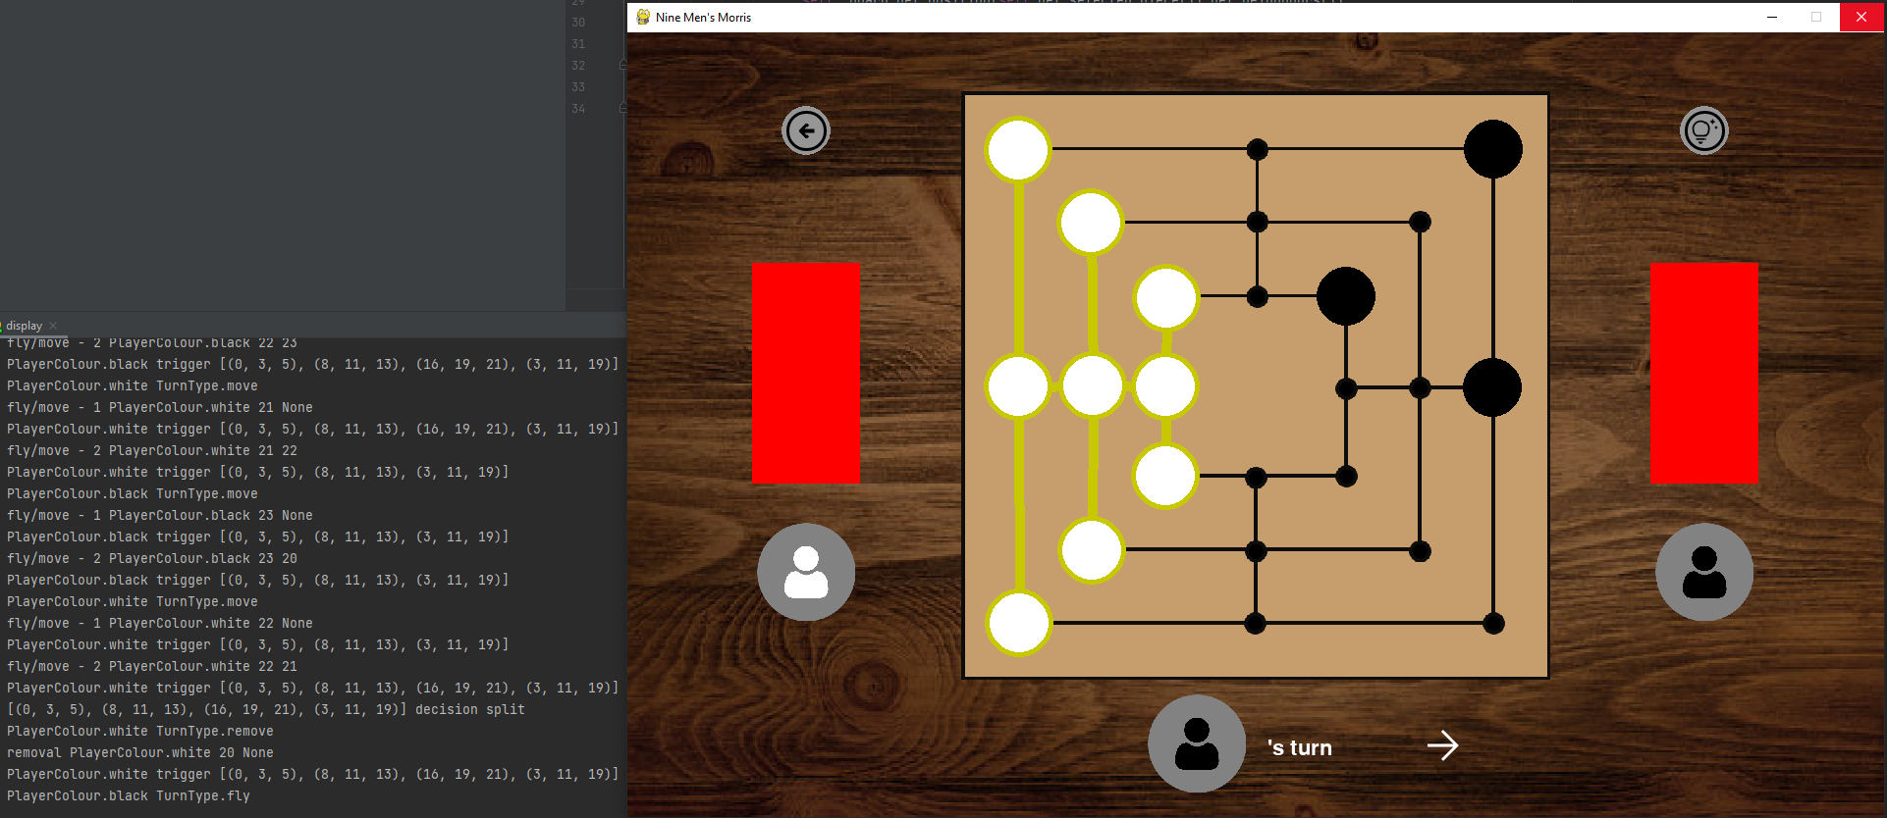
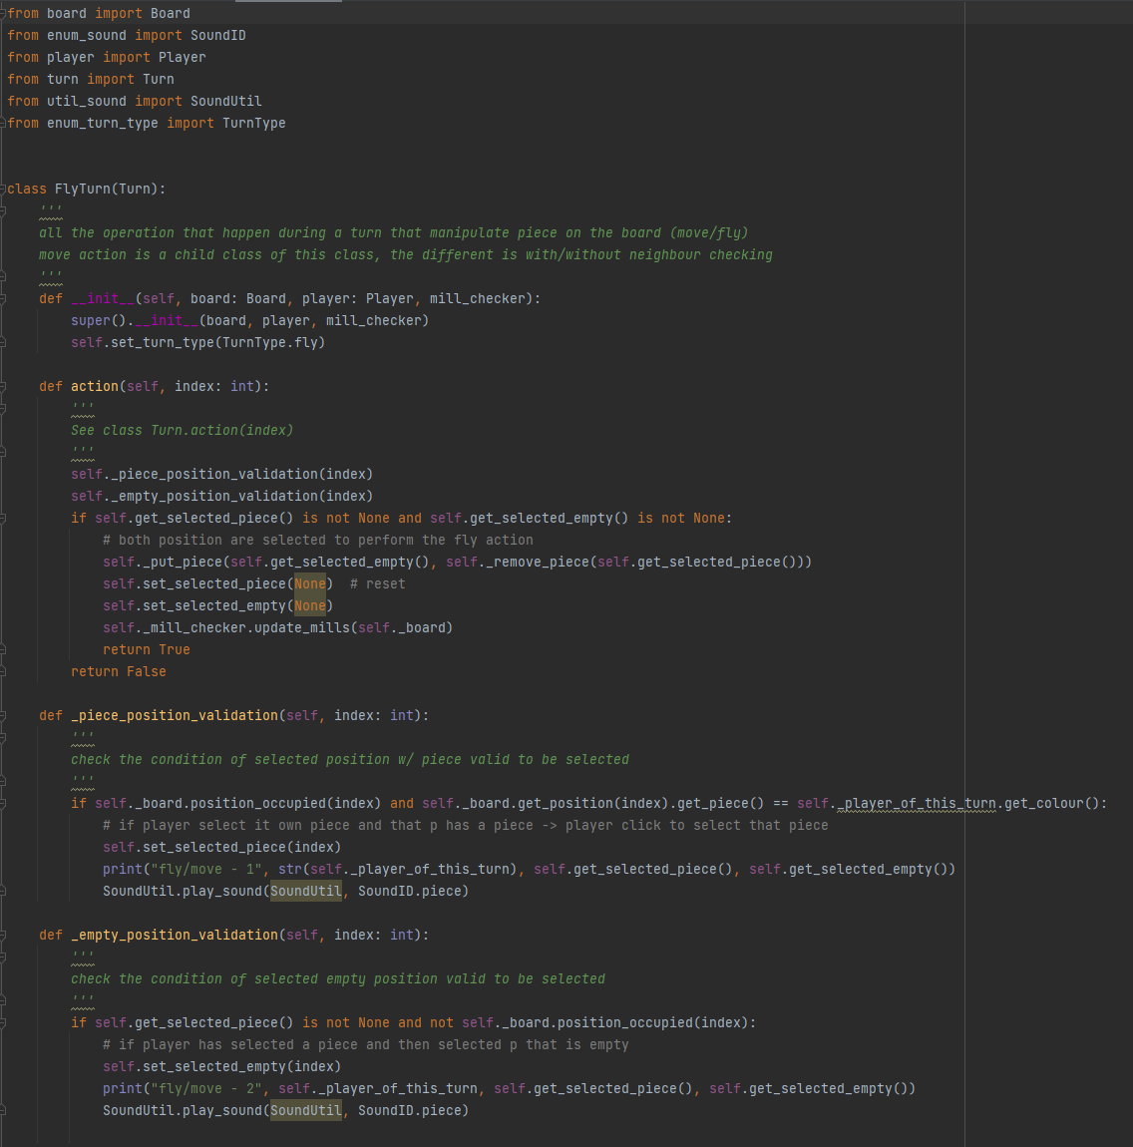
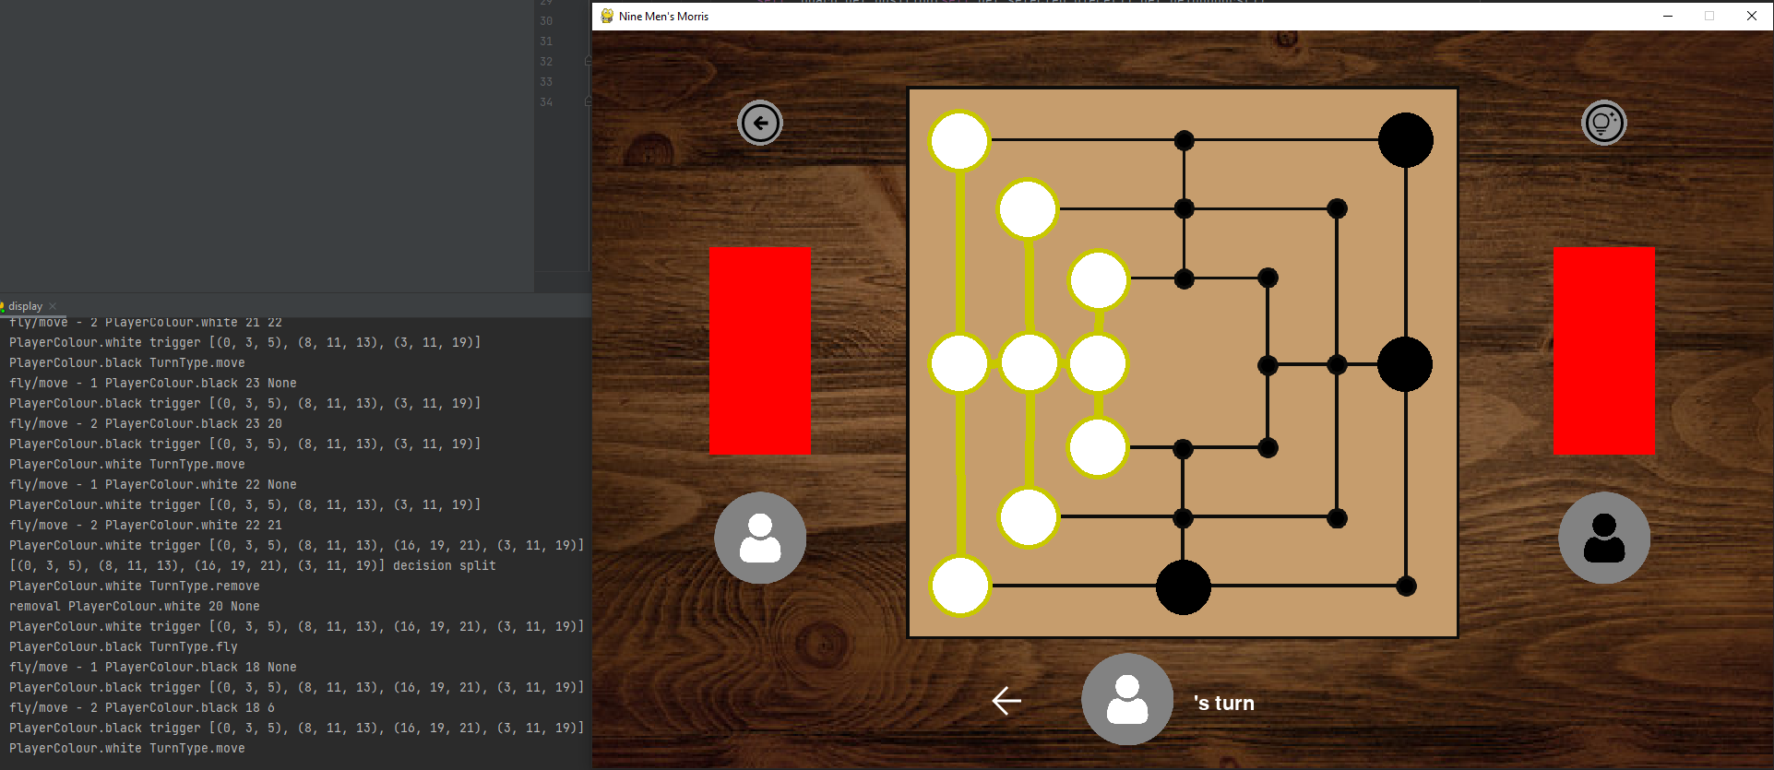
Turn - Fly

Slide 8
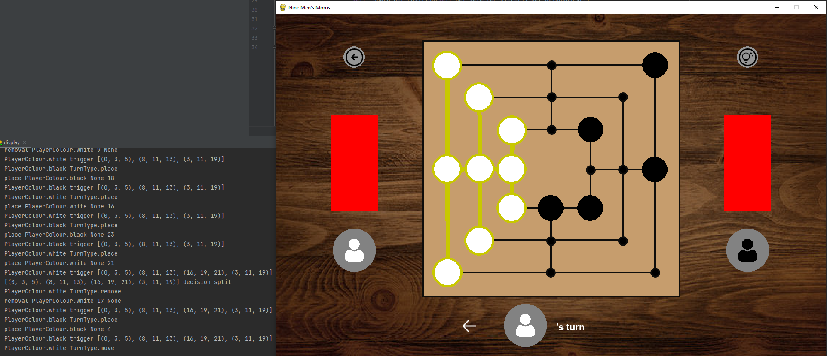
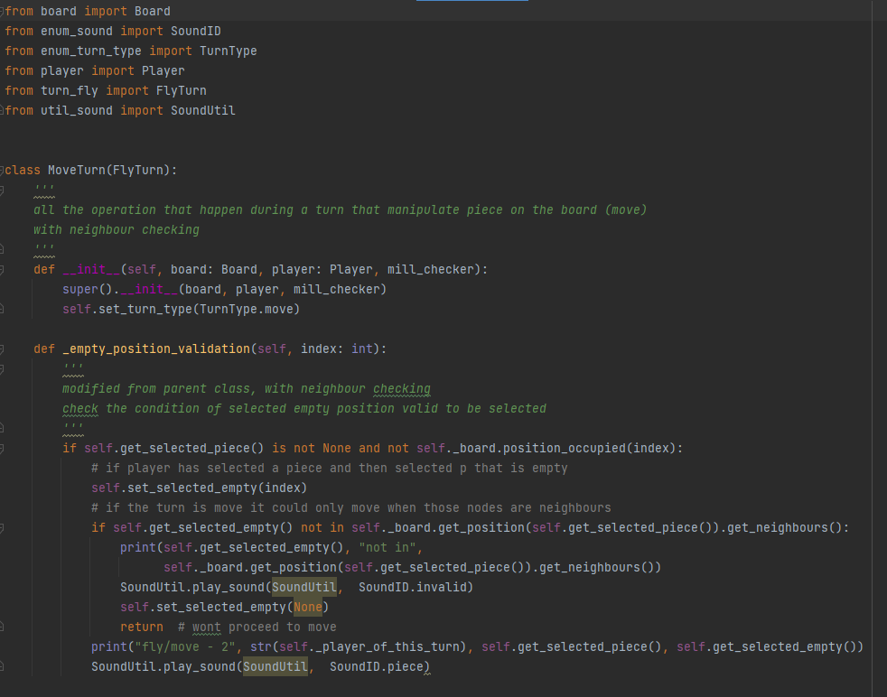
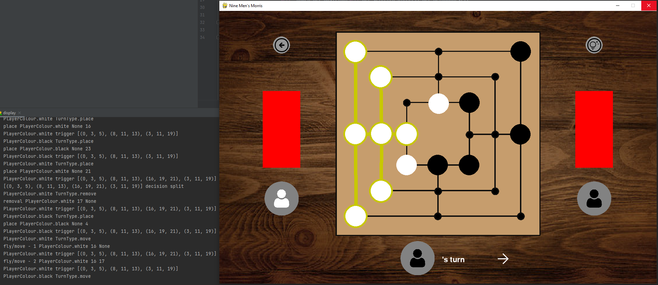
Turn - Movement

Slide 9
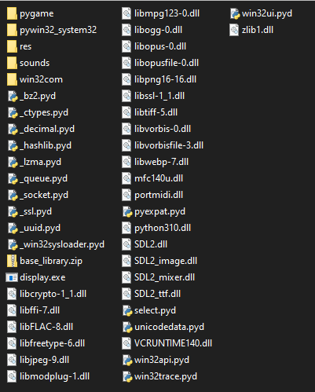

PyInstaller
Command: pyinstaller display.py Unable to compile into single file
Command would have been pyinstaller - -onefile display.py
Single file version extracts to temp folder created at runtime, cannot predict beforehand.

Slide 10
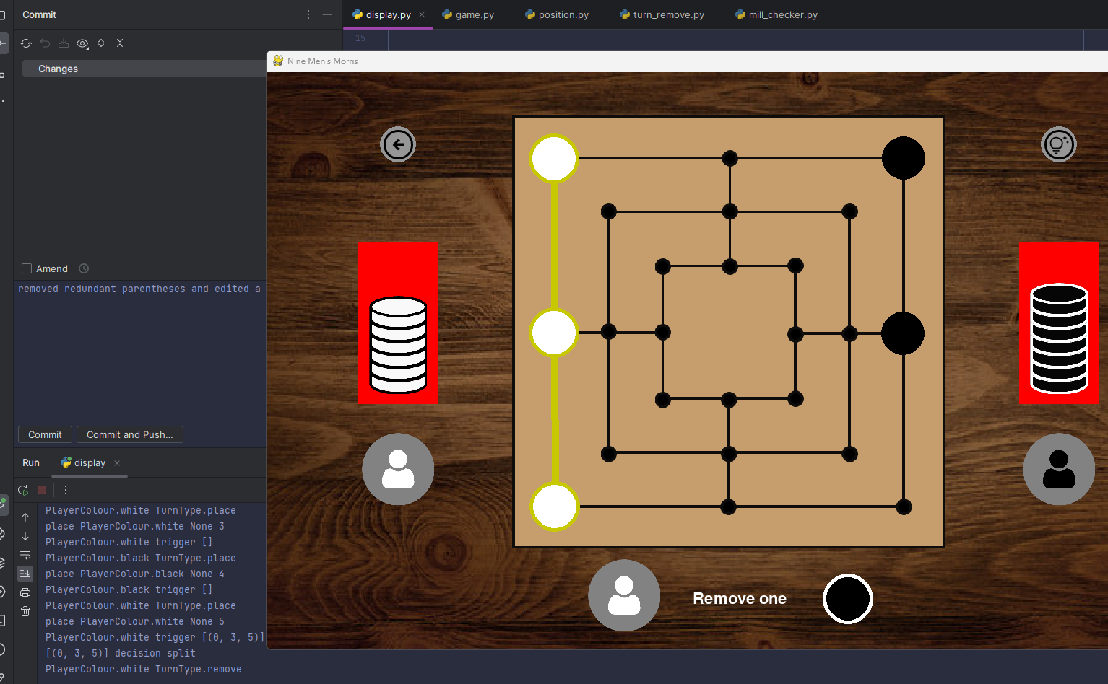
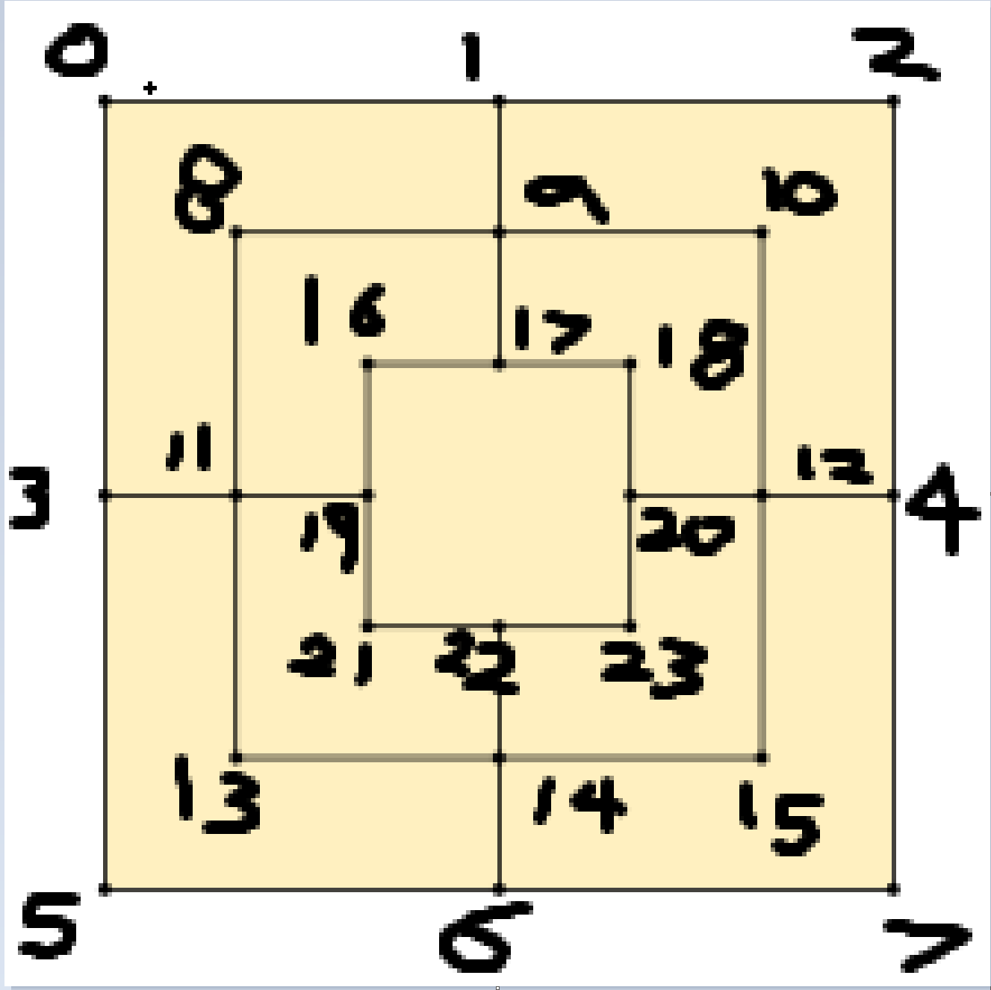
Detection of Mill
Detection of Mill
Removal turn registered
Notes:
The remove turn deletes a piece by setting the piece colour to none in the specified position in Board.

Slide 11
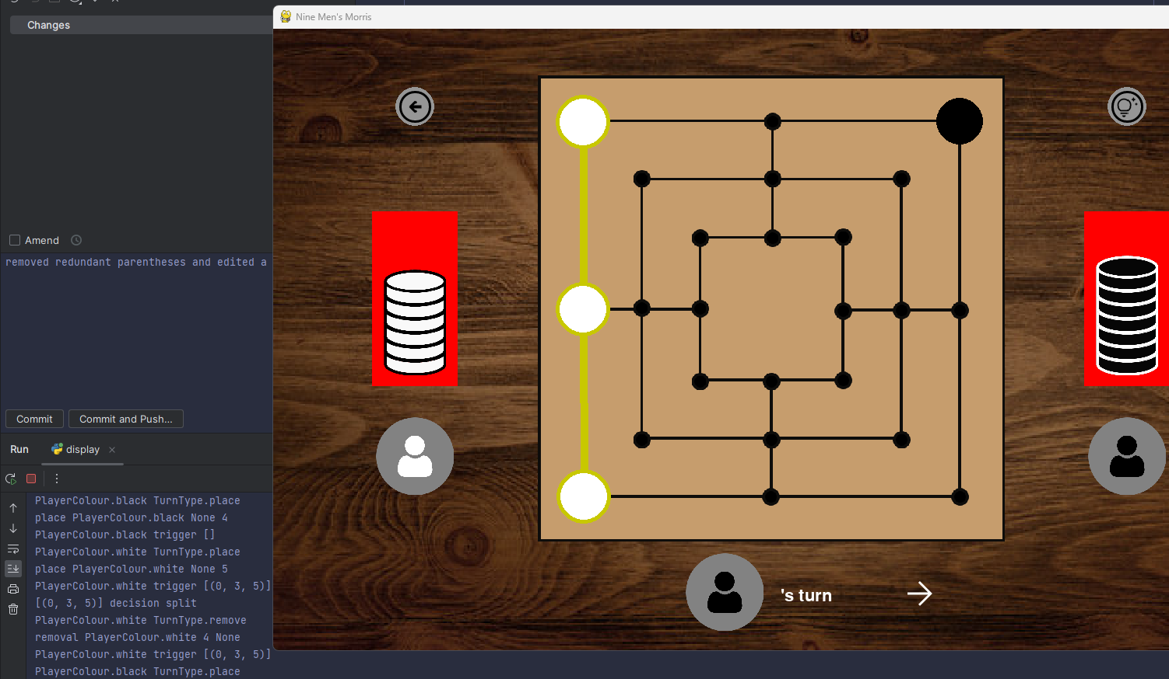
Removal
Piece at position 4 has been deleted
Notes:
The remove turn deletes a piece by setting the piece colour to none in the specified position in Board.

Slide 12
Removal and End Game Check
Turn(place/ move/fly)
Mill Checker
End Game Check
Swap Players
If new mill
Removal Turn
Deletes piece
Board
Notes:
The remove turn deletes a piece by setting the piece colour to none in the specified position in Board.

Slide 13
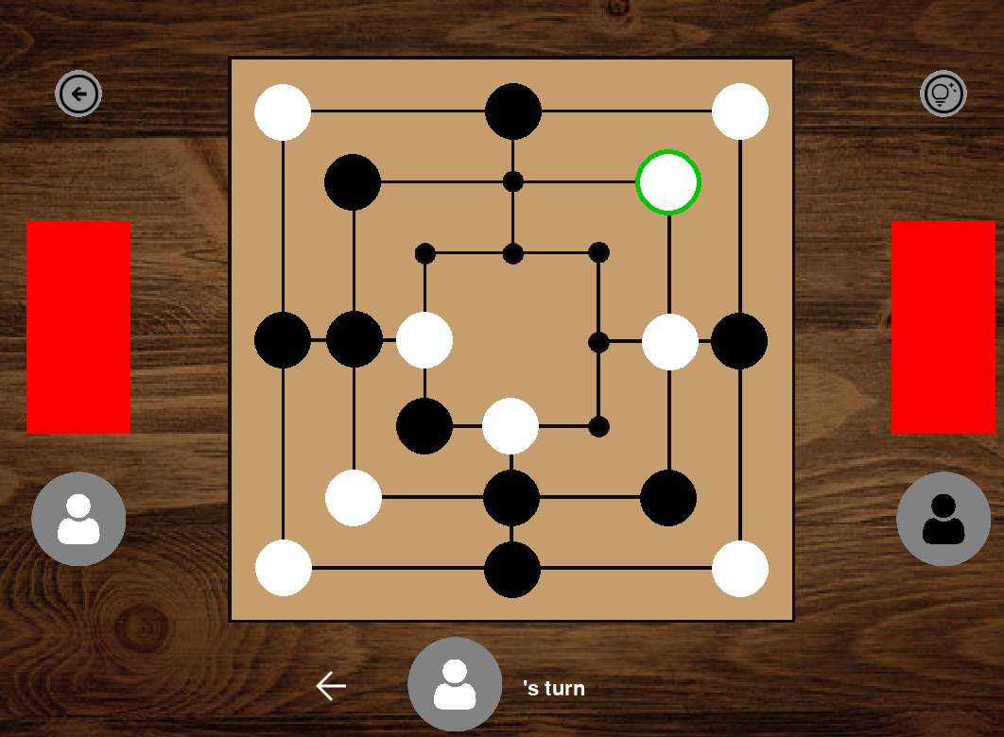
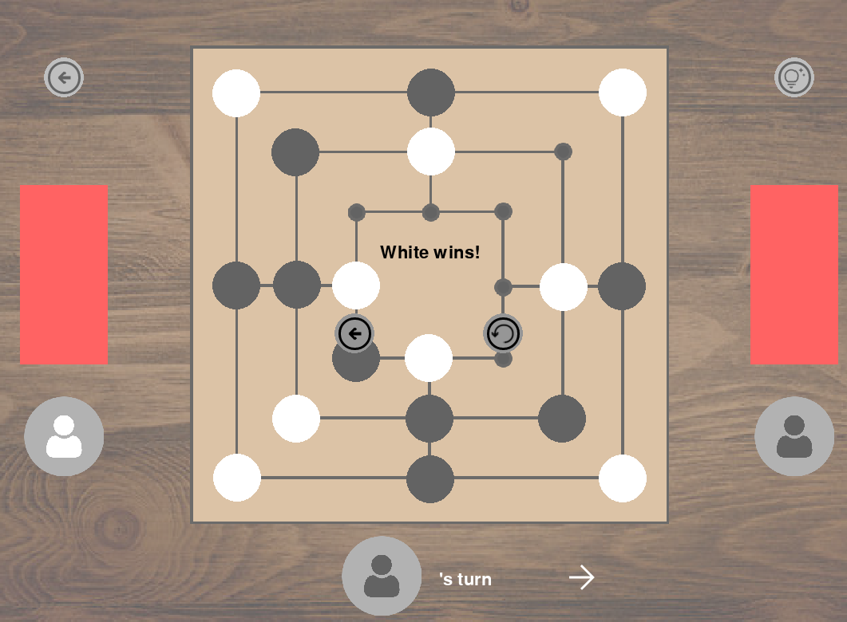
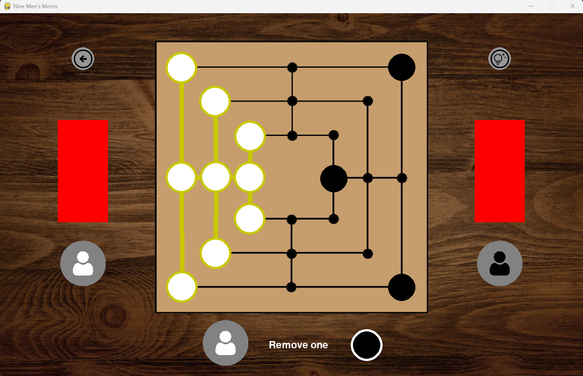
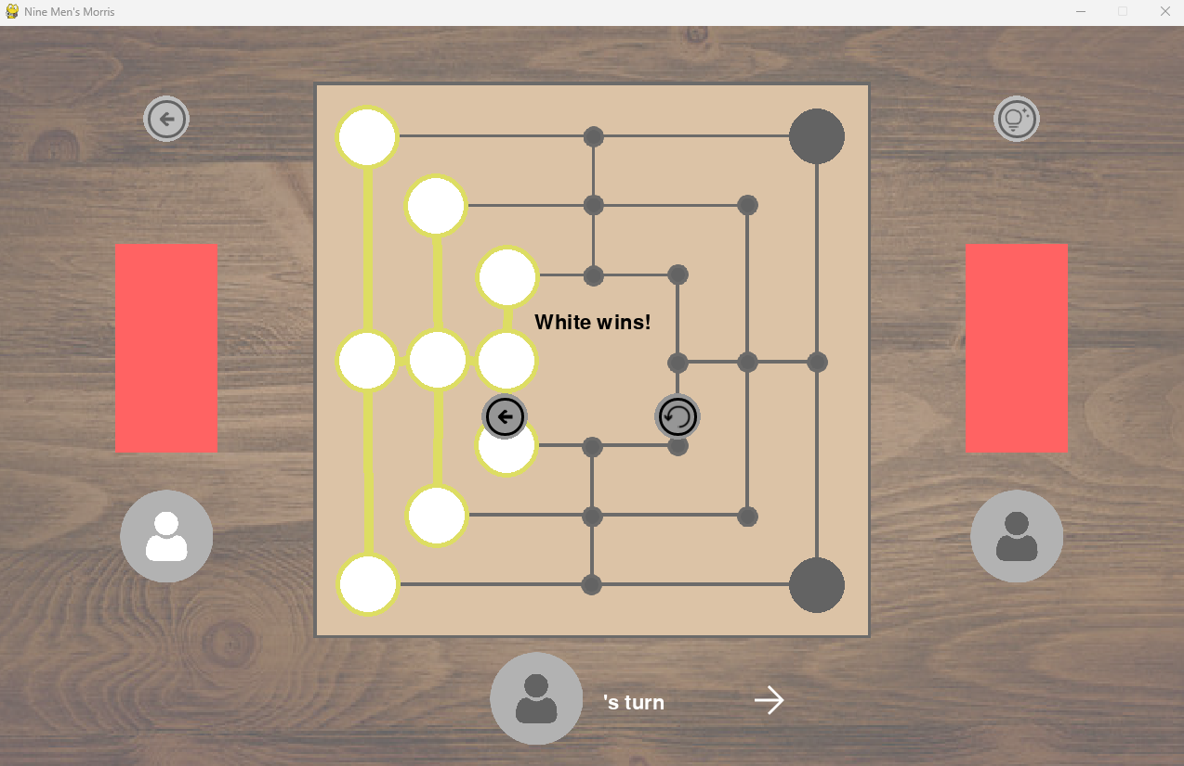
White Wins!
Notes:
White win as white moved to block black player, White win as black has less than 3 pieces remaining on the board.

Slide 14
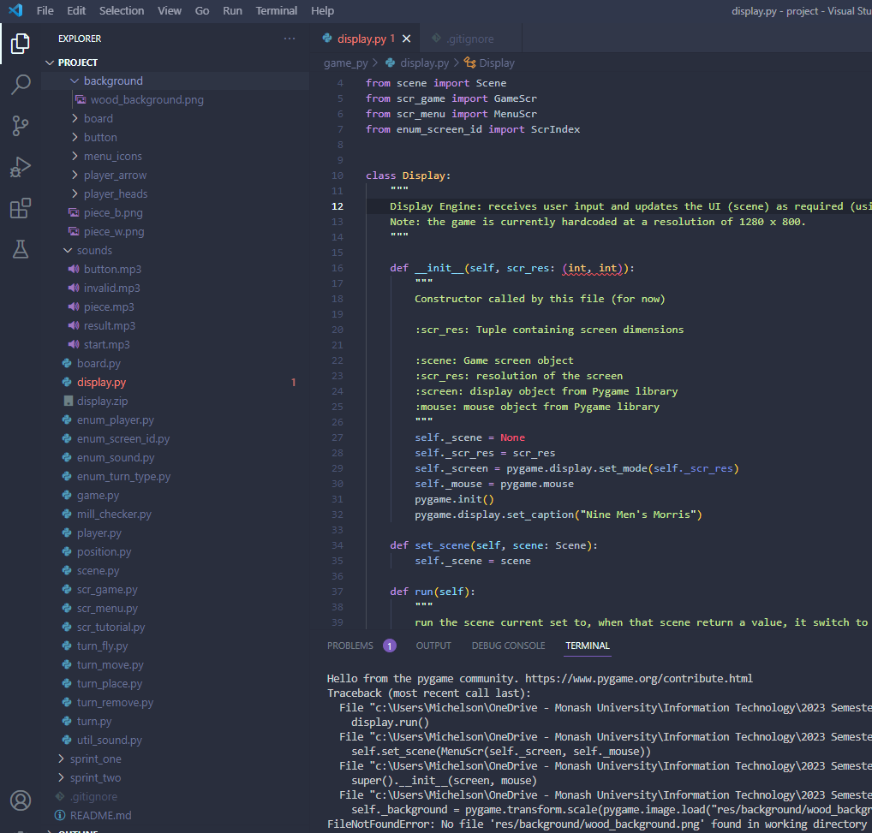
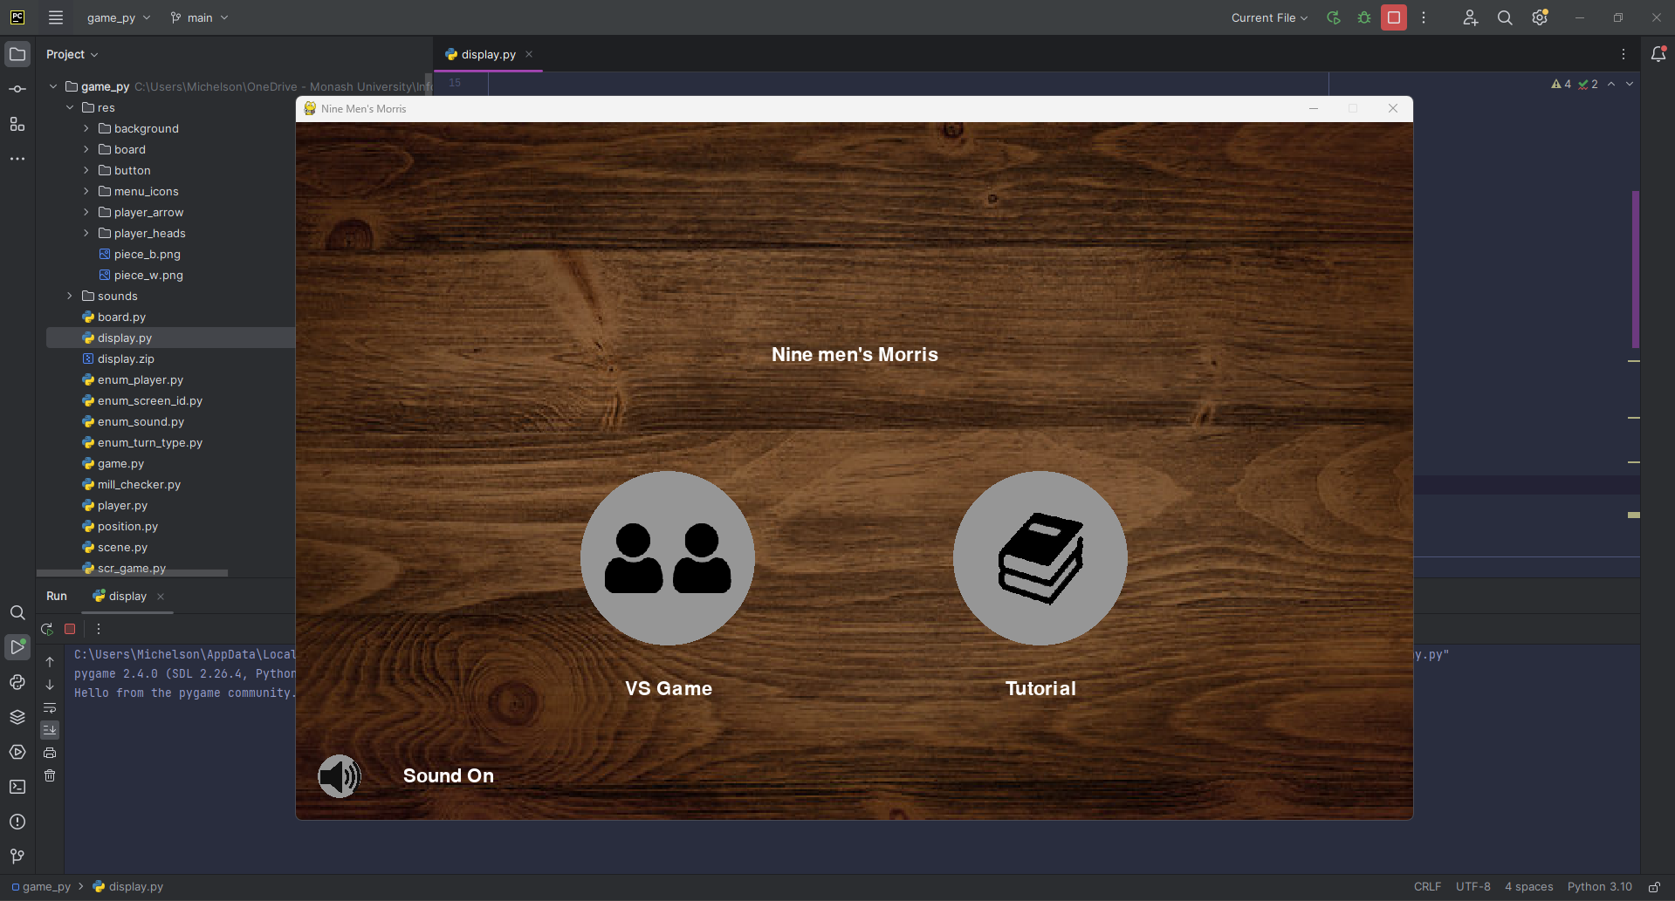
TechStack
VS Code (text editor +++)
PyCharm IDE with working display.py
Notes:
(Everyone used PyCharm). I Originally used VS Code, but getting folder permissions was a little difficult (VS Code couldn’t find files and folders and run display.py) so I installed Pycharm, which works much better as expected of an actual IDE.

Slide 15
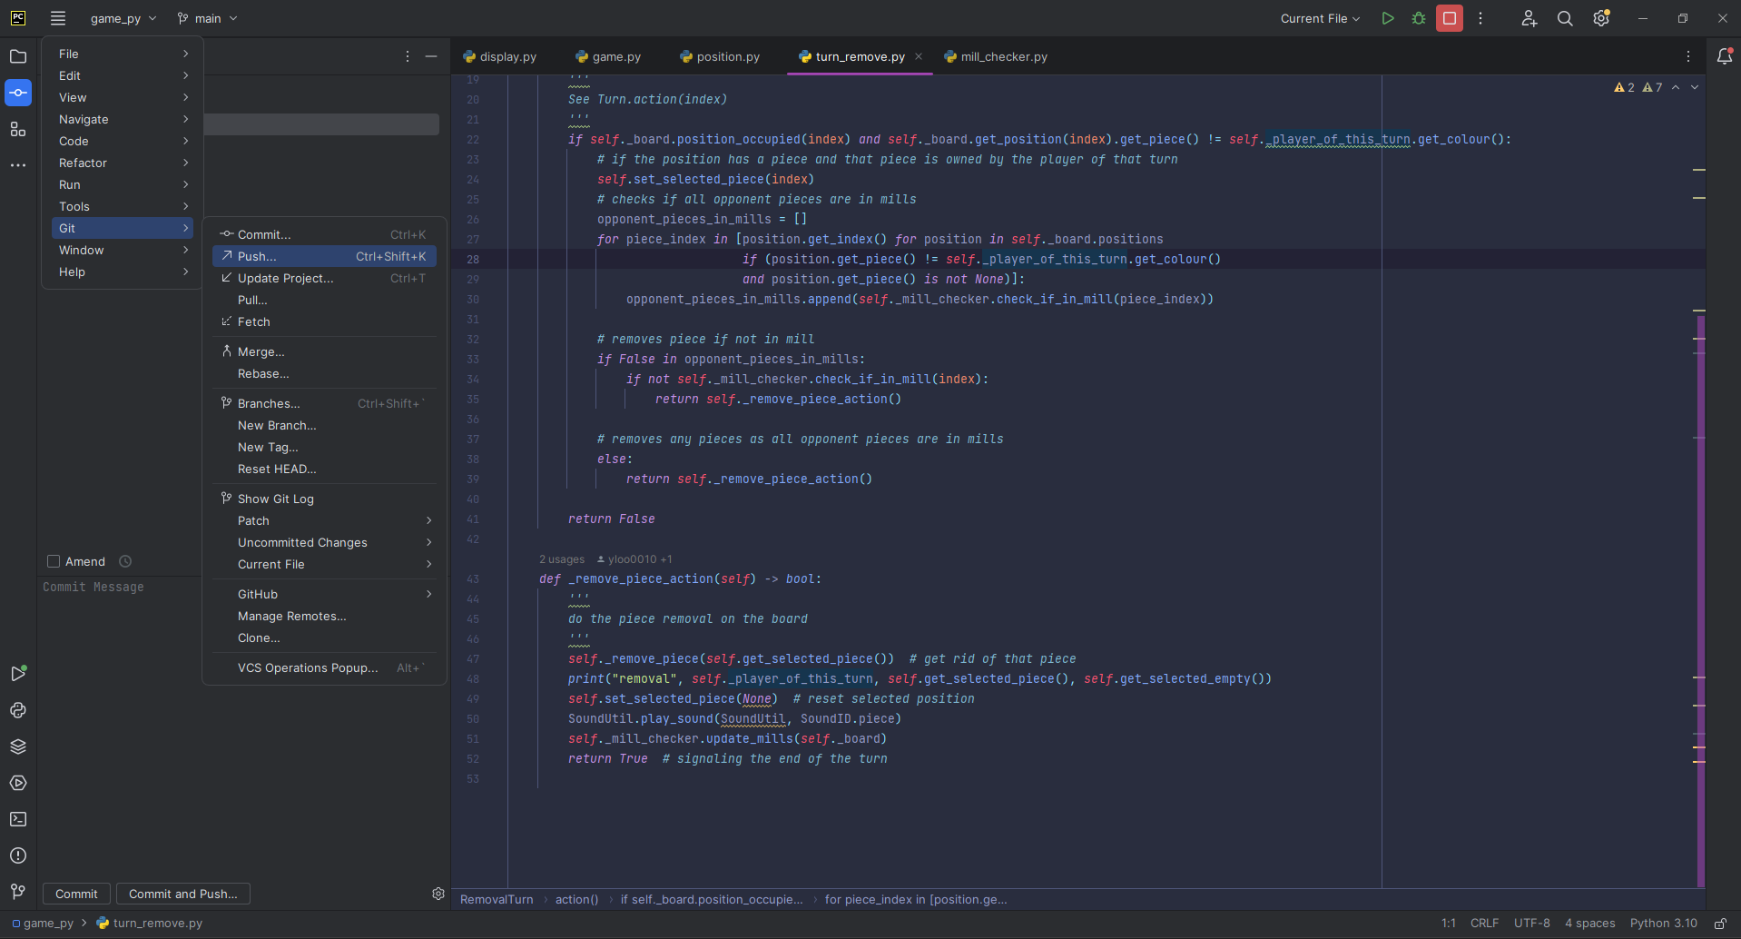


Pycharm & GIT
Find Usage / Windows Snap / Debug Tools
Basic GIT function: (Pull, Commit, Push, Rollback)
Notes:
Pycharm with Git -> easy code management (!!!Rollback!!!) -> if things goes wrong | Find Usage / Windows Snap / Debug tools step by step analyse

